Slide 1
Salesforce 101
Week 1

Slide 2
Apex
Apex is a strongly typed, object-oriented programming language that allows developers to execute flow and transaction control statements on the Force.com platform server in conjunction with calls to the Force.com API.
Looks like JAVA
Works like a stored procedure
Fires business logic
Notes:
Review github, intros for everyone.

Slide 3
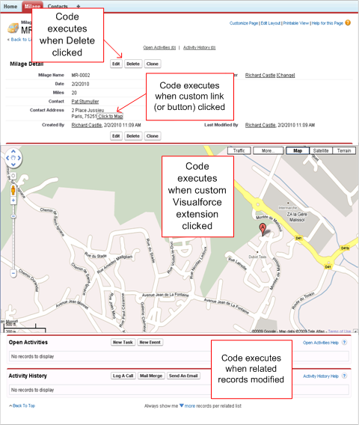
Where can it fire?
Notes:
https://developer.salesforce.com/docs/atlas.en-us.apexcode.meta/apexcode/apex_intro_what_is_apex.htm

Slide 4
Try it out
Notes:
Simple stuff using execute anonomys.

Slide 5
SOQL Query
SOQL is SFDC’s SQL language
Used to query the database
Should be used sparingly

Slide 6
Try it out
Notes:
Execute some SOQL

Slide 7
Triggers
Fire when records are updated
Are available for most objects (standard and custom)
Best practice
1 per object
No business logic in them
Before and after insert, update, and delete

Slide 8
Try it out
Notes:
Write a simple trigger

Slide 9
Unit test
All code has to be unit tested

Slide 10
Try it out

Slide 11
Homework
New custom object table called Case Routing
Name (auto number)
Type (String 255, unique)
Queue Name
When a case is created or updated and the type matches a value in the Case Routing Table, assign the record owner to the Queue.
No business logic in trigger (call a helper class).
Has to be unit tested 90% or higher.

